Slide 1
The Aftermath
Social Impact of a TV Show

Slide 2
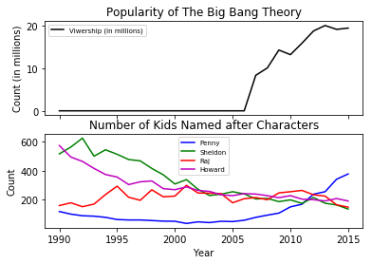
Correlation between The Big Bang Theory viewership and children named Penny : 0.864 children named Sheldon : -0.692 children named Leonard : 0.860 children named Raj : -0.073 children named Howard : -0.596

Slide 3
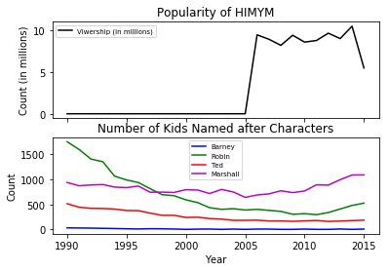
Correlation between How I Met Your Mother viewership and children named Barney : -0.490 children named Robin : -0.575 children named Ted : -0.662 children named Lily : 0.875 children named Marshall : 0.215

Slide 4
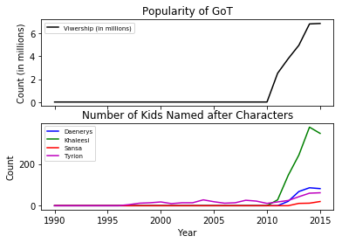
Correlation between Game of Thrones viewership and children named Daenerys : 0.954 children named Khaleesi : 0.979 children named Jon : -0.727 children named Arya : 0.794 children named Sansa : 0.889 children named Tyrion : 0.857

